Slide 1

Project 1 - Amazon Dataset Exploratory Data Analysis
Matthew Lopez, Cherline Etienne, & Mitchell Fairgrieve

Slide 2
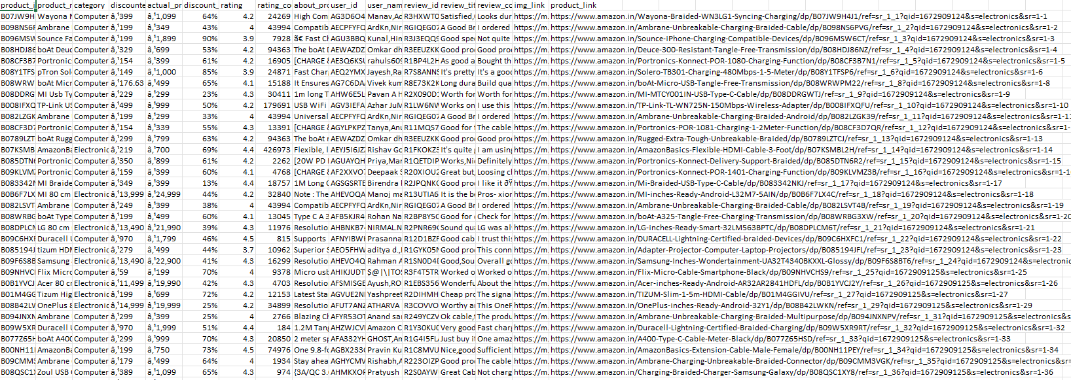
Introduction
We are using EDA to analyze a dataset containing data of 1K+ Amazon India products, ratings, and reviews.

Slide 3
Questions
What is the data breakdown by Product Category?
How does price affect ratings/reviews? Discounted-price?
What is the correlation between length of reviews vs rating?

Slide 4
Data
Amazon India Product Data set found on Kaggle
1K+ Amazon India products, ratings, and reviews.
Key Columns:
category - Category of the Product
discounted_price - Discounted Price of the Product
actual_price - Actual Price of the Product
discount_percentage - Percentage of Discount for the Product
rating - Rating of the Product
rating_count - Number of people who voted for the Amazon rating
review_title - Short review
review_content - Long review

Slide 5
Process
Imported CSV data from data set found on Kaggle
Cleaned up data, dropped NA rows, fixed formats, and converted currencies
Created various DataFrames for our analysis
Created visuals such as bar charts, pie charts, scatter plots.
Performed regression analysis and Pearson’s R test.

Slide 6
Question 1: What is the data breakdown by Product Category?

Slide 7
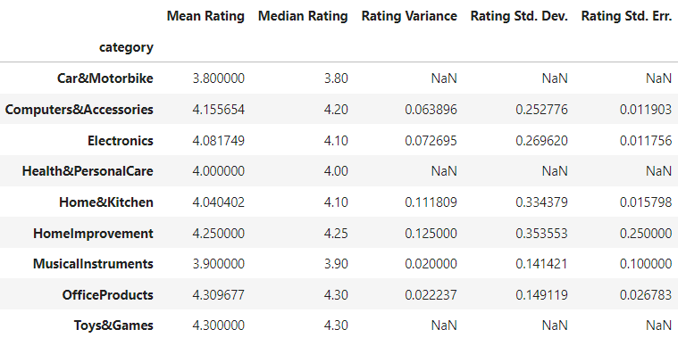
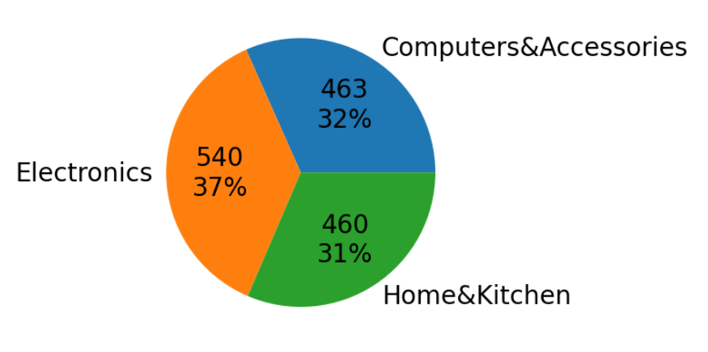
Product Category Breakdown
Initial Analysis: 9 categories total, breaking down each product. The 3 showing NaN for values have only a single row of data in the entire dataset.
Focused Categories: the 3 categories with the highest counts (next highest was Office Products - 31).

Slide 8
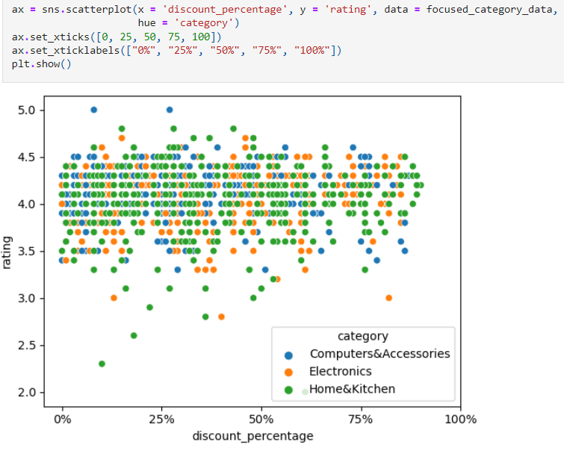
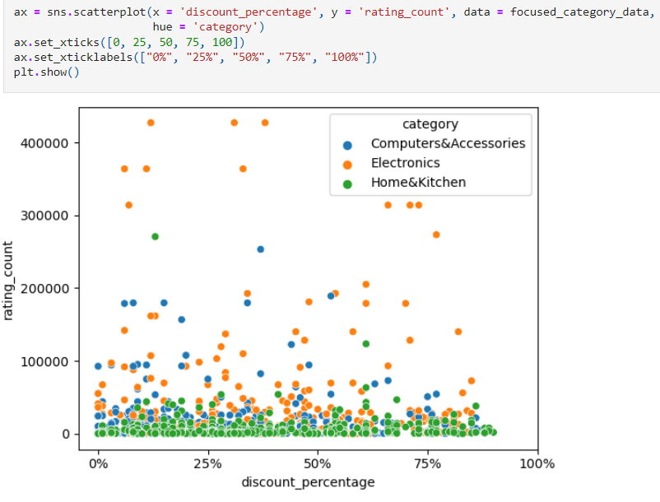
Analysis
Discounted % vs Rating
Discounted % vs Rating Count

Slide 9
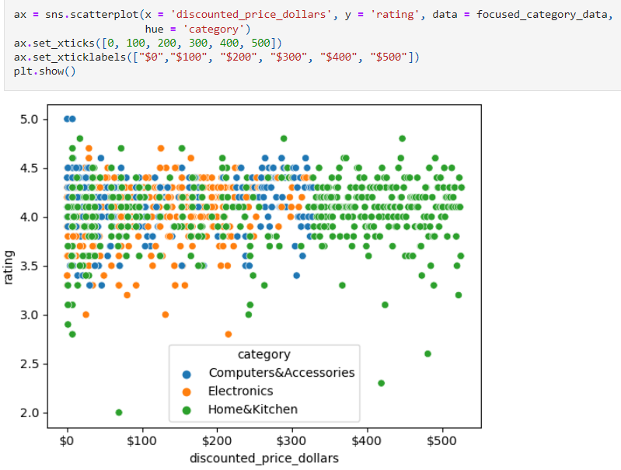
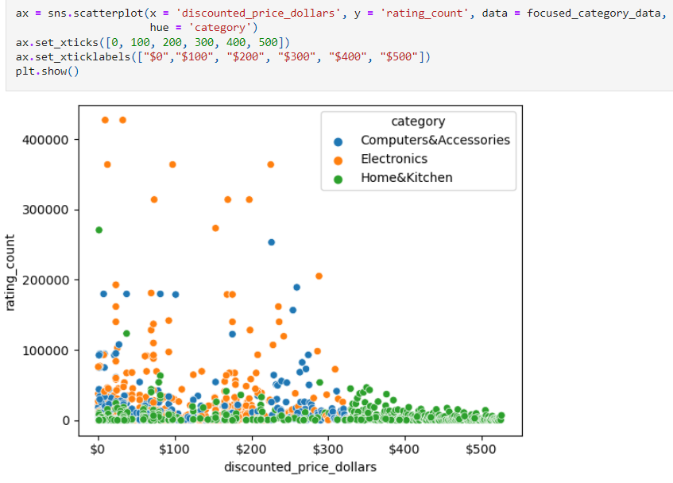
Analysis
Discounted Price ($) vs Rating
Discounted Price ($) vs Rating Count

Slide 10
Findings
Product Category: Based off our sample, there is little to no correlation between the categories and any of these tested factors.

Slide 11
Question 2: How does price affect ratings?

Slide 12
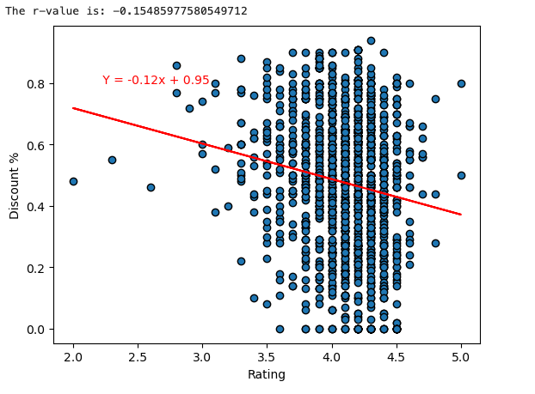
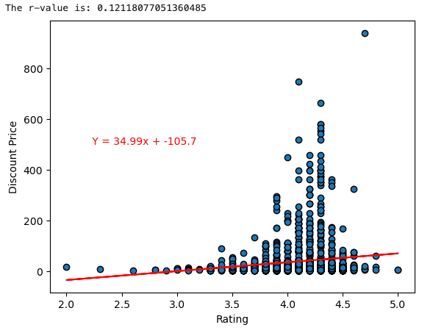
Analysis
Discount Price vs Rating
R: .121
Discount % vs Rating
R: -.155

Slide 13
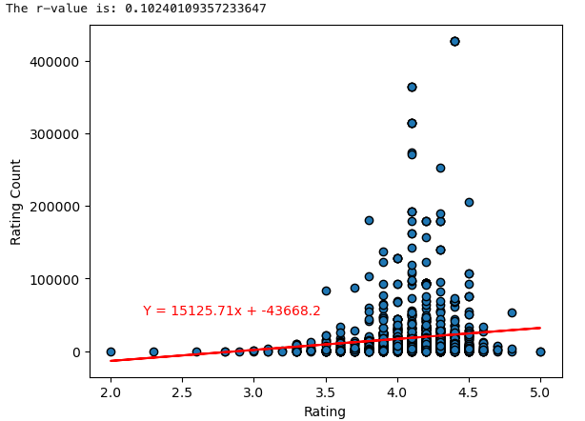
Analysis
Rating Count vs Rating
R: .102

Slide 14
Findings
Discount ($ & %) vs Rating: Based off our sample, there is little to no correlation between these two factors.
Rating vs Rating Count: Based off our sample, there is little to no correlation between these two factors.

Slide 15
Question 3: What is the correlation between length of reviews vs rating?

Slide 16
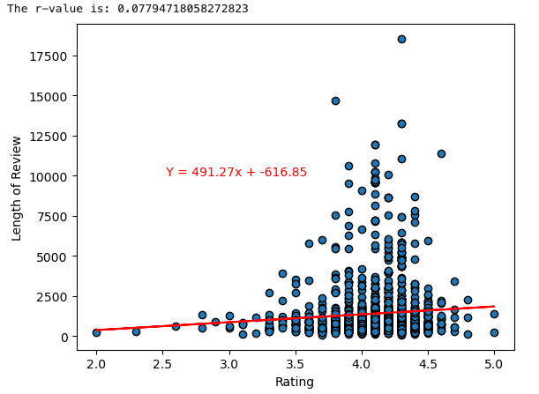
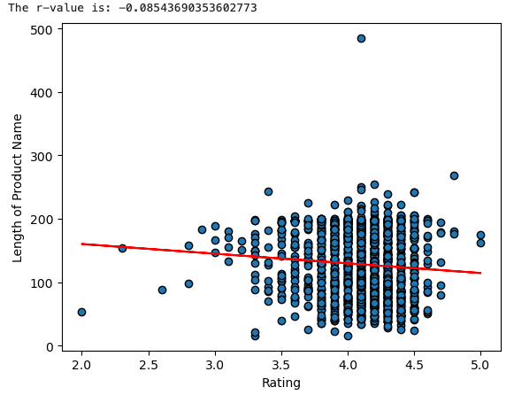
Analysis
Length of Review vs Rating
R: .078
Length of Product Name vs Rating
R: -.085

Slide 17
Findings
Review Length vs Rating: Based off our sample, there is little to no correlation between these two factors.
Product Name Length vs Rating : Based off our sample, there is little to no correlation between these two factors.

Slide 18
Hypothesis Testing
Hypothesis (Ha): If a there is a long review for a product, then the product will have a lower rating (rating < 3)
H0: There is no relationship between length and rating
Alpha = .05
Using Pearson’s R: Result(statistic=0.07794718058272823,pvalue=0.0028505813032794177)
As our P value is less than alpha, we reject the null hypothesis.

Slide 19
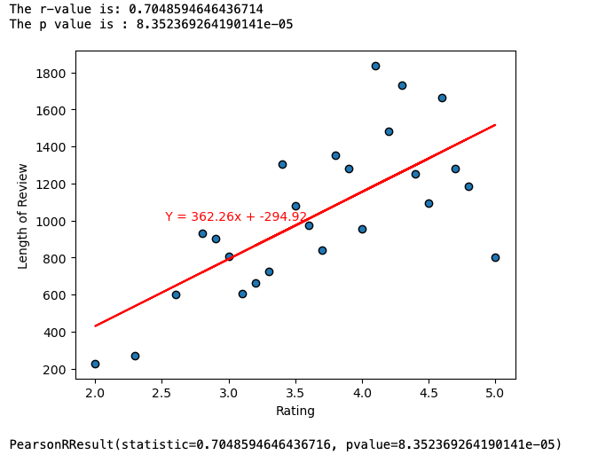
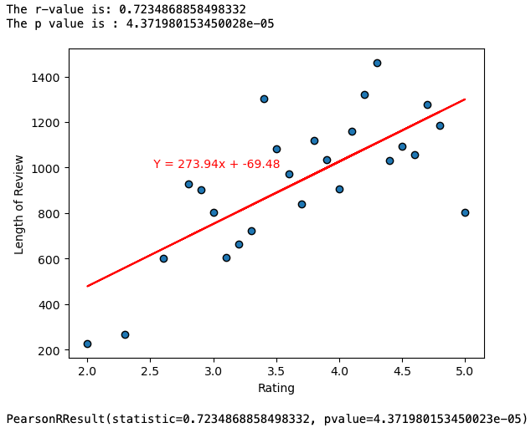
Hypothesis Testing (Cont.)
Took the average Length for each separate rating.
Excluded outliers
R = .723 and shows there is a significant correlation.
P is still less than alpha, so we can still reject the Null

Slide 20
Summary
Question 1: Initially, we had 9 major categories, however we found our data focuses on 3 main categories (Electronics, Computers&Accessories, & Home&Kitchen). Based off our sample, there is little to no correlation between the categories and any of these tested factors.
Question 2: For our sample set, we found that not of our factors have any significant correlation between the set factors.
Question 3: Based off of Pearson’s R, we rejected the Null Hypothesis. There appears to be some sort of relationship between length of review and average rating for a product. However, the relationship goes against our alternative still.

Slide 21
Main Limitations
Data set seems to be too specific in terms of products pulled:
Majority of products from only 3 categories
Majority of products with only high reviews

Slide 22
Future Ideas and expansions
Larger sample size
Perform different statistical tests
Compare to different data sets
Perform our own web scraping for data

Slide 23
Sources:
Amazon Sales Dataset : This dataset is contains the data of 1K+ Amazon India Product’s Ratings and Reviews - https://www.kaggle.com/datasets/karkavelrajaj/amazon-sales-dataset

